Slide 1
DSA ASSIGNMENT
Project name:simple library management system
Name:Pallapati Pavankumar
Regno:12217293

Slide 2
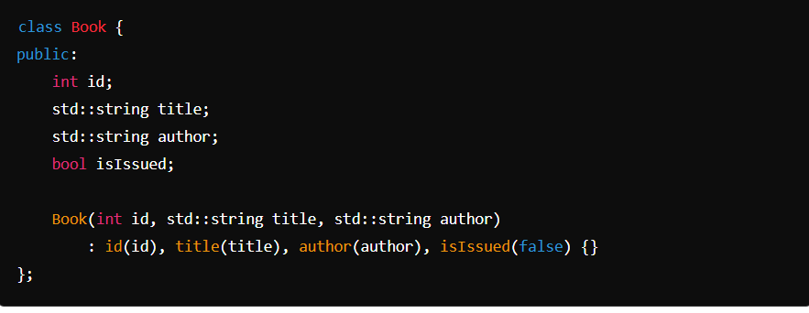
Class definition
The book class represents a book in the library

Slide 3

Library class
A C++ library consists of one or more header files and an object library. The header files provide class and other definitions needed to access the library functions. The object library provides compiled functions and data that are linked with your program to produce an executable program.

Slide 4
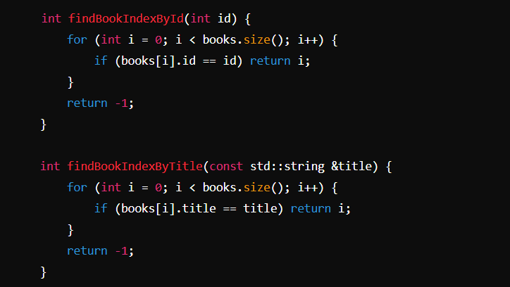
Private methods
When preceding the name of a base class, the private keyword specifies that the public and protected members of the base class are private members of the derived class. Default access of members in a class is private. Default access of members in a structure or union is public

Slide 5
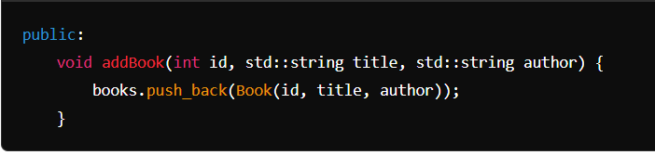
Public methods
When preceding a list of class members, the public keyword specifies that those members are accessible from any function. This applies to all members declared up to the next access specifier or the end of the class

Slide 6
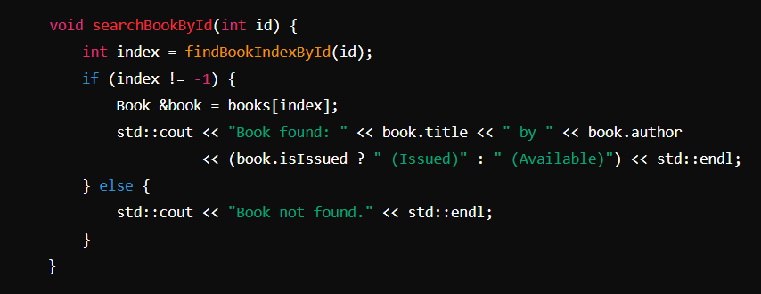
Add books
Adds a new book to the library.

Slide 7
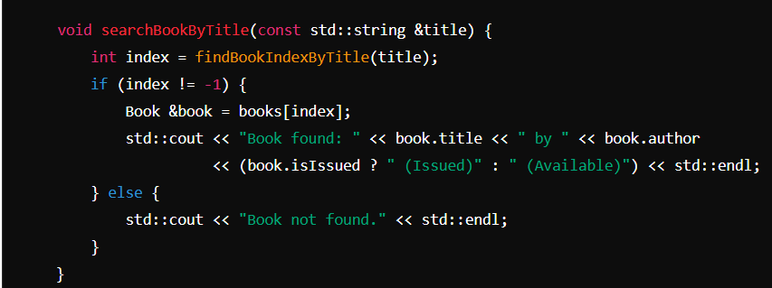
searchBookById
Searches for a book by its ID and displays its details.

Slide 8
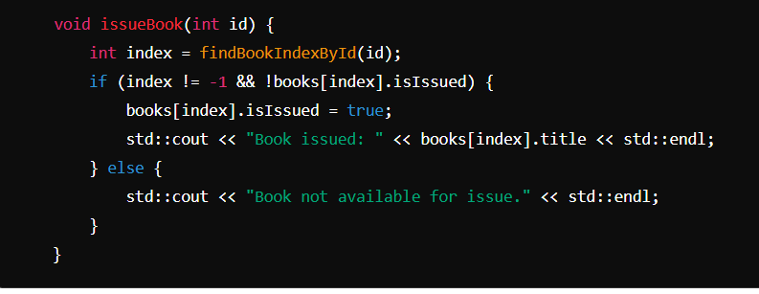
searchBookByTitle
Searches for a book by its title and displays its details.

Slide 9
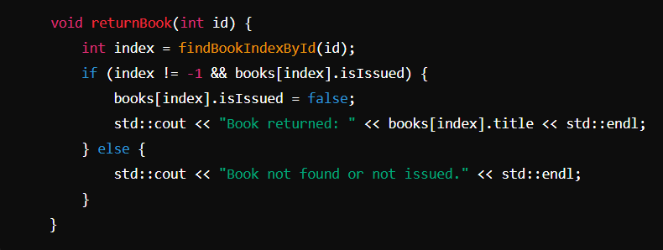
issueBook:
Changes the status of a book to issued if it is available.

Slide 10
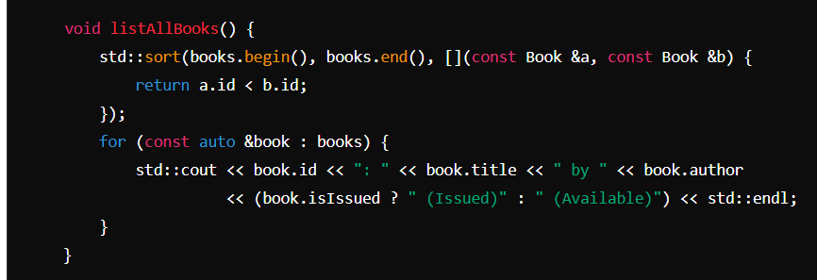
returnBook
Changes the status of a book to available if it is issued.

Slide 11
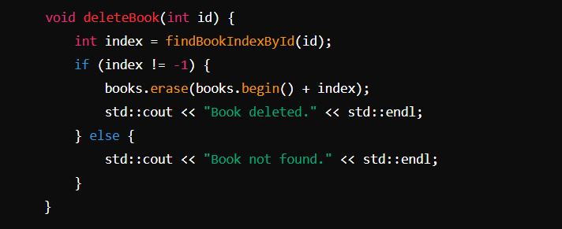
listAllBooks
Lists all books in the library, sorted by their IDs.

Slide 12
Main Function
Main Menu: Displays a menu for the user to choose an action.
Switch Case: Handles the user's choice and performs the corresponding action (adding, searching, issuing, returning, listing, or deleting books).
Loop: The menu continues to be displayed until the user chooses to exit.

Slide 13
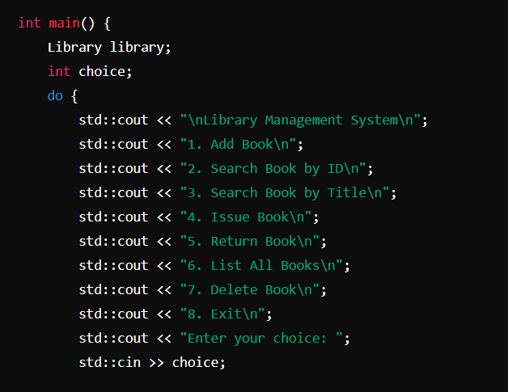

Slide 14
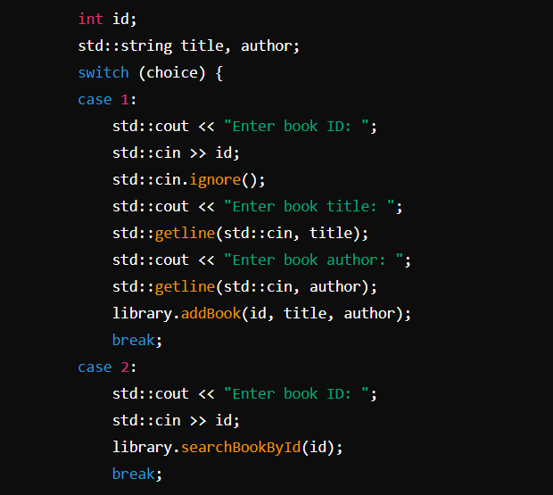

Slide 15
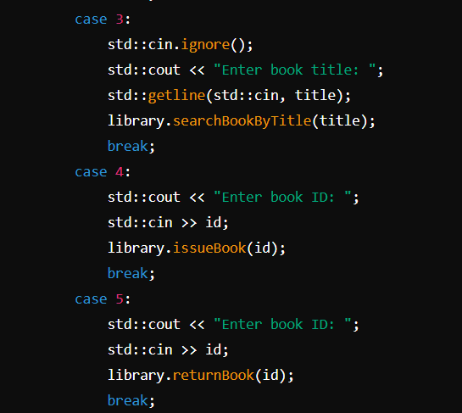

Slide 16
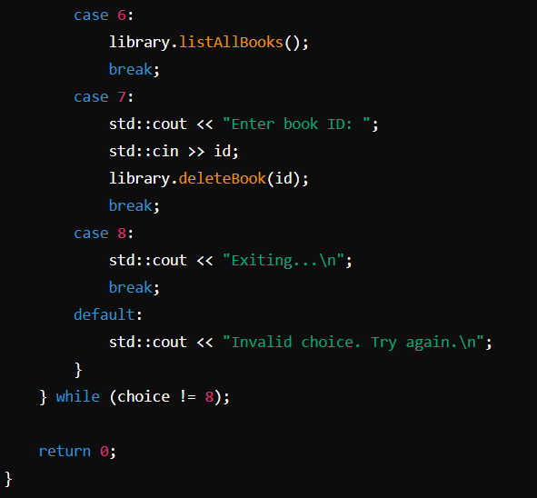

Slide 17
Summary
Book Class: Represents individual books.
Library Class: Manages a collection of books and implements the required operations.
Main Function: Provides a user interface to interact with the library system.
This should give you a clear understanding of how the code works and how it implements the features of the library management system.

Slide 18
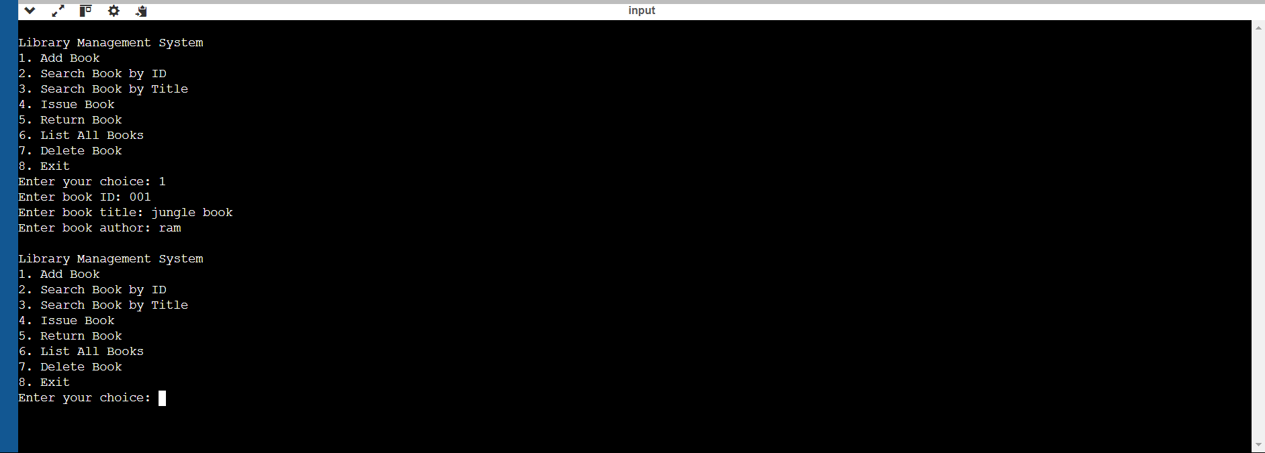
Output:

